Slide 1
Cloud Native Data Flow Orchestration
Mark Fisher | Patrick Peralta
@m_f_ | @patrickperalta

Slide 2
Safe Harbor Statement
The following is intended to outline the general direction of Pivotal's offerings. It is intended for information purposes only and may not be incorporated into any contract. Any information regarding pre-release of Pivotal offerings, future updates or other planned modifications is subject to ongoing evaluation by Pivotal and is subject to change. This information is provided without warranty or any kind, express or implied, and is not a commitment to deliver any material, code, or functionality, and should not be relied upon in making purchasing decisions regarding Pivotal's offerings. These purchasing decisions should only be based on features currently available. The development, release, and timing of any features or functionality described for Pivotal's offerings in this presentation remain at the sole discretion of Pivotal. Pivotal has no obligation to update forward looking information in this presentation.

Slide 3
Overview
Streaming and Batching with Spring XD
From Modules to Microservices
Orchestration by Spring Cloud Data Flow
Demos
Local
YARN
Lattice
Cloud Foundry

Slide 4
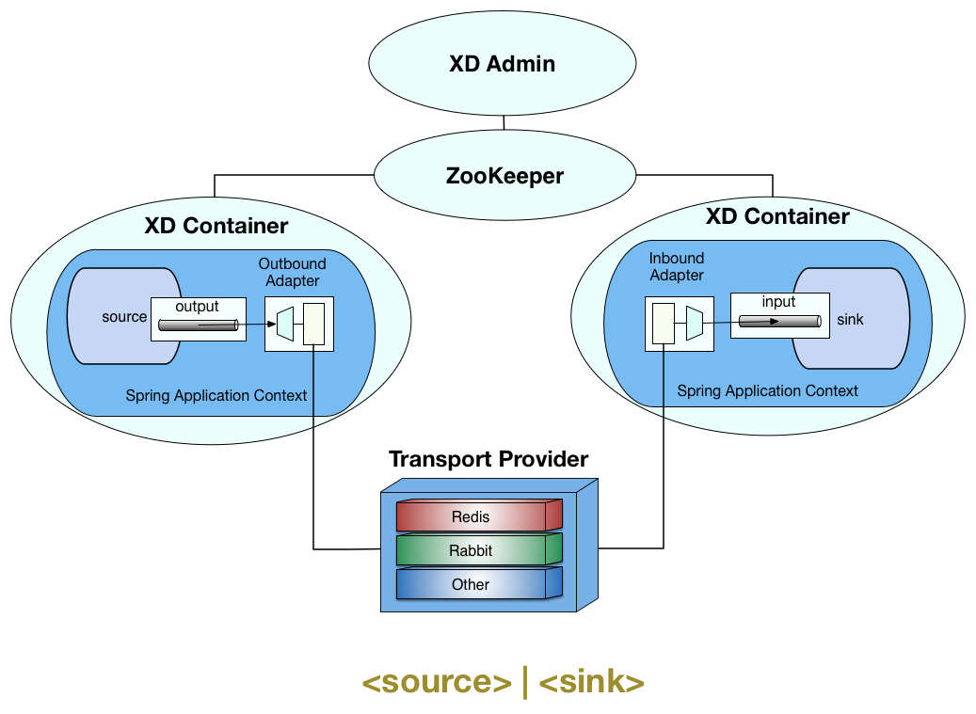
Streaming and Batching with Spring XD

Slide 5
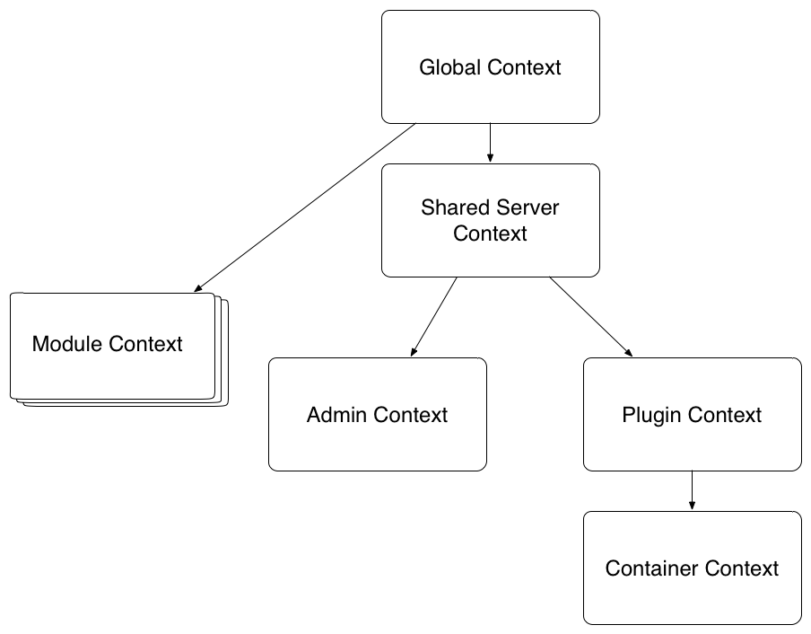
Spring XD Modules
Execute inside of a Spring XD Container
Consist of beans in an application context
Multiple modules may run in a container, each with their own class loader

Slide 6
Room For Improvement
Custom module development was somewhat complex
Classloader issues, jar proliferation in the lib directory
Feature requests for a more dynamic distributed runtime (scale up, down)
From | To
Modules | Microservices
Built in distributed runtime | Distributed runtime SPI (Cloud Foundry, Lattice, YARN)

Slide 7
From Modules to Microservices
XD
Spring Cloud Data Flow
REST API, Shell, UI
Module Deployer SPI:
Singlenode
Lattice
YARN
Cloud Foundry
Admin
Modules
Spring Cloud
Stream Modules
Spring Cloud
Task Modules
OOTB modules
Executable Boot Apps
Container
Spring Cloud
Stream
Spring Cloud
Task
Boot for Spring Integration and Batch
Auto-Configuration, Bindings

Slide 9
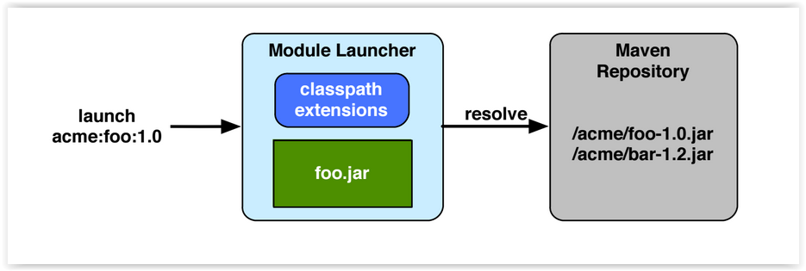
Module Launcher
Resolves module artifacts from a Maven Repository
Extends classpath and launches the application
Supports co-location of modules

Slide 10
Spring XD 1.x
Spring Cloud Stream
Host
Host
Container
Container
M
M
M
M
M
M
M
M
M
M
SPI Implementation
ZooKeeper
Spring Cloud Data Flow (optional)
Modules are executable Boot apps
Easier to use Spring Cloud features
Easier to test, consistent dev experience
Portable and “cloud-native”
Modules run inside containers
Container is a Boot app
Modules are ApplicationContexts

Slide 11

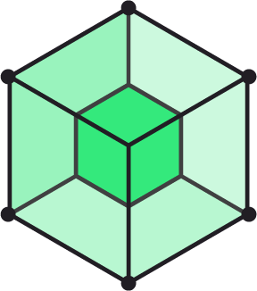

Demos
Local
YARN
Lattice
Cloud Foundry

Slide 12
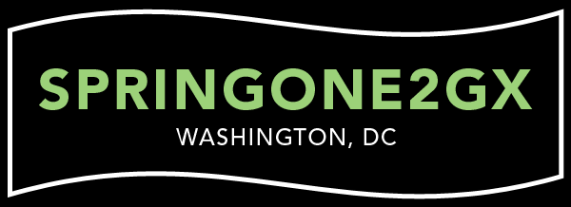


Learn More. Stay Connected.
@springcentral
Spring.io/video
Stream Processing at Scale with Spring XD and Kafka
Marius Bogoevici - September 16, 2015 14:30 - 16:00
Hadoop Workflows and Distributed YARN Apps using Spring technologies - Thomas Risberg, Janne Valkealahti
September 16, 2015 10:30 - 12:00

